Slide 1


DEPARTMENT OF ARTIFICIAL INTELLIGENCE AND MACHINE LEARNING
Meta Cognitive Temperature Regulation for Transformer Models
Mrs. Sangeetha K
SURWEESH SP
231501165
Assistant Professor

Slide 2

INTRODUCTION
Large Language Models (LLMs) built upon the Transformer architecture have revolutionized Artificial Intelligence by demonstrating exceptional capabilities in natural language understanding, reasoning, code generation, scientific discovery, and conversational intelligence.
Despite these remarkable advances, their inference mechanism of modern Transformer models remains fundamentally static. During text generation, decoding decisions are governed by externally defined hyperparameters such as temperature, Top-k, Top-p, and beam search. Among these, the temperature parameter controls the randomness of token selection and is typically assigned manually by the user before inference begins.
This assumption introduces a significant limitation. Human reasoning is inherently adaptive we naturally become more cautious when uncertain, explore multiple alternatives for complex problems, and respond deterministically when confidence is high.
This research proposes Meta-Cognitive Temperature Regulation (MCTR), a novel inference framework that enables Transformer models to continuously assess their internal cognitive state and dynamically regulate decoding temperature during generation. Inspired by human meta-cognition, the framework estimates confidence, uncertainty, reasoning stability, and novelty before each prediction, allowing the model to adapt its exploration strategy rather than relying on a static user-defined parameter.

Slide 3
IMPORTANCE OF THE TOPIC
As LLMs become increasingly integrated into healthcare, education, finance, law, scientific research, autonomous systems, and software engineering, ensuring reliable reasoning has become more critical than simply improving accuracy.
Current Transformer models exhibit several well-known limitations:
Hallucination of incorrect facts
Overconfident incorrect predictions
Static decoding behaviour
Poor uncertainty awareness
Lack of self-reflection during reasoning
Fixed exploration regardless of task complexity,
although recent research has explored adaptive decoding and temperature optimization, these methods primarily adjust output sampling strategies and do not introduce an explicit mechanism for computational self-awareness.
Recent works such as
Adaptive Decoding via Latent Preference Optimization,
Thermometer of Thoughts, and
TAMPO demonstrate the growing importance of adaptive inference but remain focused on optimizing decoding policies rather than modelling a model's internal cognitive state.

Slide 4
PROJECT OVERVIEW
The proposed research introduces Meta-Cognitive Temperature Regulation (MCTR), a self-regulating inference framework for Transformer-based Large Language Models.
Instead of using a fixed decoding temperature throughout inference, the proposed system estimates the model's internal cognitive state including confidence, uncertainty, reasoning stability, and novelty, and dynamically predicts an optimal temperature for every decoding step.
The framework consists of four major components:
Transformer Backbone
Meta-Cognitive State Estimator
Dynamic Temperature Controller
Adaptive Decoding Module

Slide 5
EXISTING SYSTEM
Current Transformer-based Large Language Models perform inference using a fixed decoding strategy. During token generation, probability distributions are adjusted using manually selected hyperparameters such as:
Temperature
Top-k Sampling
Top-p Sampling
Beam Search
Repetition Penalty
Several recent studies have proposed adaptive decoding methods that dynamically adjust temperature or attention during inference.
Adaptive Decoding via Latent Preference Optimization selects decoding temperatures according to task characteristics, while Thermometer of Thoughts adjusts attention temperature to diversify reasoning.
TAMPO further models temperature as a learnable meta-policy during reinforcement learning.

Slide 6
PROBLEM STATEMENT
Current Transformer architectures generate outputs using externally specified decoding parameters without evaluating the reliability of their internal reasoning process. As a result, models cannot distinguish between situations requiring deterministic reasoning and those requiring broader exploration. This limitation contributes to hallucinations, overconfidence, inconsistent reasoning, and poor calibration. There is therefore a need for a self-regulating inference framework that continuously estimates the model's cognitive state and dynamically adapts decoding behaviour to improve reasoning reliability and trustworthiness.

Slide 7
OBJECTIVES AND SCOPE
OBJECTIVE
SCOPE
Design a Meta-Cognitive Temperature Regulation framework for Transformer models.
Develop a Meta-Cognitive State Estimator capable of measuring confidence, uncertainty, reasoning stability, and novelty.
Predict decoding temperature dynamically during inference.
Improve reasoning accuracy while maintaining computational efficiency.
Reduce hallucination and overconfidence. Improve calibration and interpretability.
Benchmark the framework on standard reasoning datasets.
Included
Transformer-based LLMs
Dynamic temperature prediction
Meta-cognitive state estimation
Inference-time regulation
Open-source foundation models
Mathematical and reasoning benchmarks
Hallucination analysis
Calibration evaluation
Excluded
Training a foundation model from scratch
Multimodal reasoning
Speech and vision processing
Hardware optimization
Distributed training infrastructure

Slide 8
LITERATURE SURVEY
Recent studies have demonstrated the benefits of adaptive decoding, attention-temperature modulation, and meta-cognitive decision making. However, existing approaches generally optimize isolated components such as temperature scheduling, attention scaling, or tool invocation. None introduces a unified inference framework that continuously models the Transformer's internal cognitive state and uses it to regulate decoding behaviour throughout the reasoning process.
The proposed Meta-Cognitive Temperature Regulation framework addresses this gap by integrating self-evaluation directly into inference, enabling adaptive and cognitively inspired reasoning.

Slide 9
LITERATURE SURVEY
Author/ Year | Title | Methodology/ Approach | Key Inference
Vaswani et al. (Transformer baseline) | Attention Is All You Need | Self-attention architecture | Foundation of Transformer models
Ouyang et al. (2022) | Training Language Models to Follow Instructions with Human Feedback | RLHF | Improved instruction following
Jiang et al. (2023) | Mistral 7B | Sliding-window attention | Efficient inference
OpenAI (2023) | GPT-4 Technical Report | Large scale transformer | Emergence reasoning
Yao et al. (2023) | Tree of Thoughts | Deliberate reasoning search | Improved reasoning exploration
Chuang et al. (2025) | Learning to Route LLMs with Confidence Tokens | Self-REF + confidence tokens +routing/rejection | Converts model confidence into downstream routing decisions

Slide 10
LITERATURE SURVEY
Author/ Year | Title | Methodology/ Approach | Key Inference
Ma et al. (2025) | Large Language Models Have Intrinsic Meta-Cognition, but Need a Good Lens | AutoMeco + MIRA; step-level meta-cognition evaluation | Shows that LLMs contain measurable meta-cognitive signals and studies how to evaluate them
Xu et al. (2024) | SaySelf: Teaching LLMs to Express Confidence with Self-Reflective Rationales | Supervised fine-tuning + RL for confidence calibration | Enables fine-grained confidence and self-reflective uncertainty explanations
Li et al. (2024) | Think Twice Before Trusting: Self-Detection for Large Language Models through Comprehensive Answer Reflection | Candidate generation + reflection + answer-space comparison | Improves detection of unreliable outputs through retrospective self-evaluation
Xiong et al. (2024) | Can LLMs Express Their Uncertainty? An Empirical Evaluation of Confidence Elicitation in LLMs | Prompting, sampling, response consistency | Establishes systematic methods for eliciting uncertainty/confidence from LLMs

Slide 11
SUMMARY OF LITERATURE SURVEY
1. Transformer-based inference
Established self-attention as the core mechanism for contextual information processing.
Provides the computational foundation for MCTR.
Gap: The Transformer does not explicitly monitor its own confidence, uncertainty, stability, or novelty to regulate subsequent computation.
2. Confidence and self-assessment
Recent work enables language models to express and evaluate their own confidence through self-reflection.
Establishes the feasibility of a measurable self-assessment mechanism.
Gap: Confidence is primarily expressed or evaluated rather than converted into a continuous inference-time control signal.
3. Intrinsic meta-cognition
Recent research demonstrates that LLMs contain measurable internal meta-cognitive signals.
Supports the idea of constructing a meta-cognitive state from the model's own inference.
Gap: These signals are mainly used for measurement and analysis rather than for dynamically regulating the model's next computational state.
4. Confidence-based inference control
Confidence can be used to make inference-time decisions, such as routing or selective computation.
Demonstrates that model self-assessment can influence computational behavior.
Gap: Existing control generally operates at the system/model-selection level rather than directly regulating the same Transformer's decoding temperature and attention.

Slide 12
RESEARCH GAP
Author/ Year | Title | Methodology/ Approach | RESEARCH GAP
Vaswani et al. (Transformer baseline) | Attention Is All You Need | Self-attention architecture | MCTR adds a meta-cognitive control layer over the Transformer.
Ouyang et al. (2022) | Training Language Models to Follow Instructions with Human Feedback | RLHF | MCTR moves feedback from external training supervision toward internal computational regulation.
Jiang et al. (2023) | Mistral 7B | Sliding-window attention | MCTR makes information allocation state-dependent rather than only architecture-dependent.
OpenAI (2023) | GPT-4 Technical Report | Large scale transformer | MCTR proposes an explicit computational mechanism rather than relying on emergent reasoning capability.
Yao et al. (2023) | Tree of Thoughts | Deliberate reasoning search | MCTR introduces internal state-based regulation instead of primarily external search over reasoning paths.

Slide 13
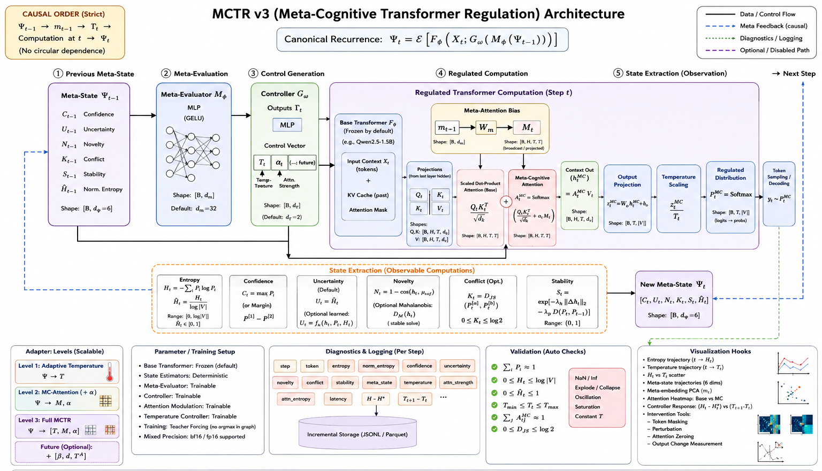
ARCHITECTURE DIAGRAM

Slide 14
TECH STACK
PYTHON : NUMPY, MATPLOTLIB, TORCH, HUGGING FACE
DATASET (for evaluation): MMLU, ARC, GSM8K

Slide 15
LIST OF MOUDULES
PHASE 1 | PHASE 2
BASE STATISTICS | ADAPTIVE ENTROPY TARGET
INFORMATION-THEORETIC STATE | TEMPERATURE CONTROLLER
INFERENTIAL STATE | META-COGNITIVE ATTENTION
META-COGNITIVE EVALUATOR | REGULATED TRANSFORMER
META CONTROLLER | STATE TRANSITION

Slide 16
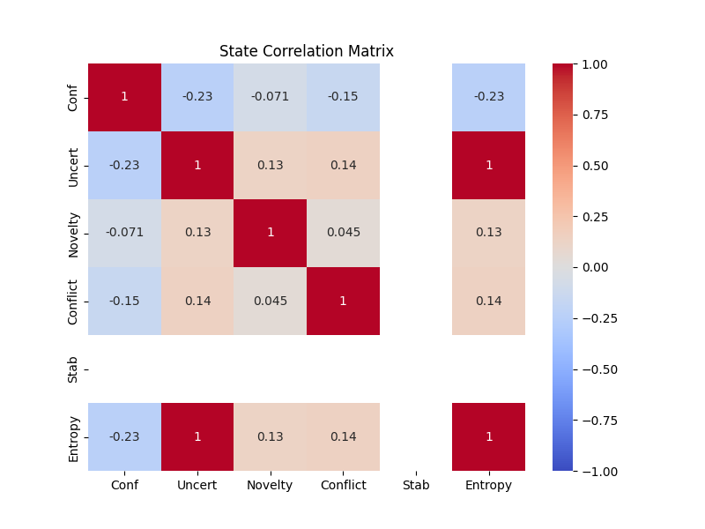
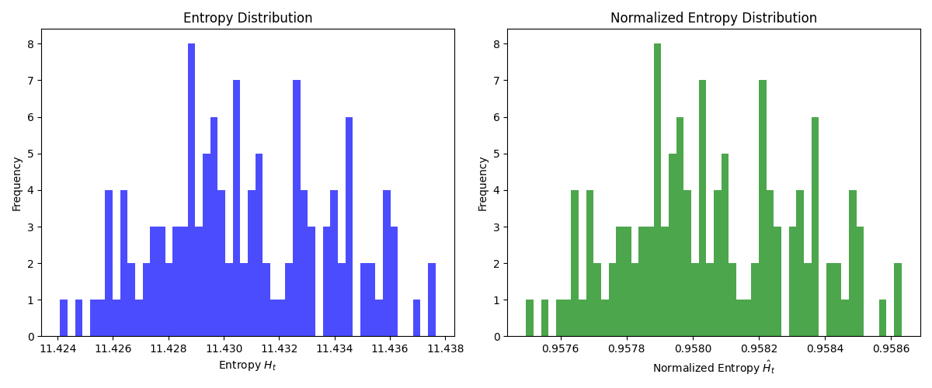
STATISTICAL INFERENCE

Slide 17
Thank You

